Slide 1


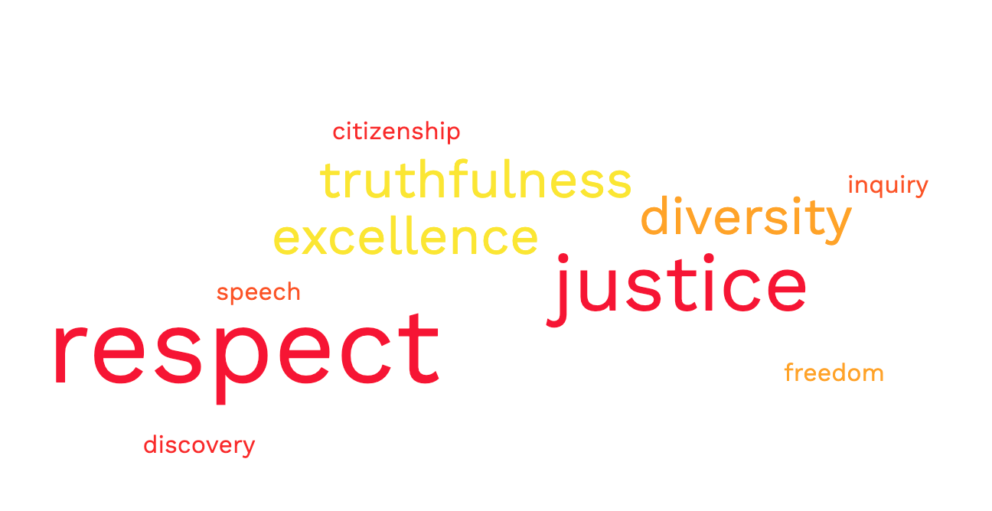

Granum & Aurum
By: Hannah Shortino
Advisors: Dr. Jillian Volpe White, Brittany Devies, Ellie Foreman
What is Granum & Aurum?
A service for FSU departments to receive feedback about their different programs. Especially, if the data collection cannot be solved using survey, a program evaluation, internal interviews, or data that already lives within the office.
Figure 1
Results
FSU students have minimal to no knowledge of the Seminole creed. (Figure 1)
“Um, online orientation went really fast. Like they were speeding through cause like they didn't have time” (Morgan)
“This is my first time, seeing it…and I think other people should read it be more exposed to it.” (Keith)
    Students believe the Seminole Creed values are upheld despite minimal exposure and are reflective of student experiences at Florida State University. (Figure 2)
    “I wouldn't say so, I think that you know it's been it's been a pretty representative of my experience so far.” (Mark)
    “I feel like for the most part, most FSU staff or even FSU students that I talked to kind of like, show me these and then return I think I show them too.” (Nancy)
    Students believe that the Seminole Creed is important to know and should be more visible on campus and more integrated into student life. (Figure 3)
    “I don't think people like if I go up to someone, I'm like, What's the Seminole creed? I don't think they're gonna know what it is. I don't think they know anything about it.” (Nancy)
    I haven't seen it like posted on the wall anywhere, like, I haven't seen any of this at all. And I mean, it would be pretty easy to just even just put the words up somewhere or like for teachers to talk about it more.
    References
    Goss, Jon D. "Introduction to focus groups." Area 28.2 (1996): 113-114.
    Heyink, J. W., and T. J. Tymstra. "The function of qualitative research." Social Indicators Research 29.3 (1993): 291-305.
Case Study: Seminole Creed
Granum and Aurum was approached by FSU New Student & Family Programs about the visibility and knowledge of the Seminole Creed at Florida State University.
Students attended a G&A focus group session where they were asked a series of questions about the Seminole Creed.
All focus groups receive the same questions about the subject.
Data was recorded and coded for major themes and sent back to the Department for their evaluation.
Research Questions
Is the Seminole Creed reflective of the FSU student body?
Supplemental Questions
What do you know about the Seminole Creed?
What do others in the FSU community know about the Seminole Creed?
In what ways do these values align with your FSU experience? In what ways do they diverge?
How can you see these values being integrated into the FSU community?
Figure 2
Figure 3
Acknowledgements
Thank you to Dr.Volpe White, Brittany Devies and Ellie Foreman for allowing me to work on Granum and Aurum. Thank you to my UROP mentors, Guisella Cruz and Michelle Evangelista for their assistance throughout this experience.

